Slide 1
Unit 8:
Weather, Water & Climate
Part I: Weather
Topic 1: cyclonic weather
Topic 2: Weather instruments
Topic 3: weather variables
Topic 4: air masses & fronts

Slide 2
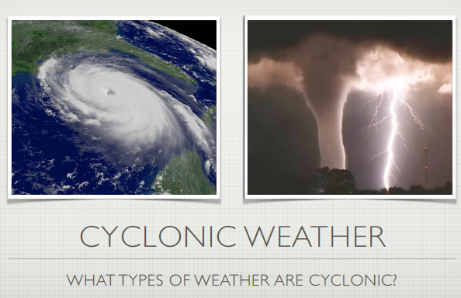

Slide 3
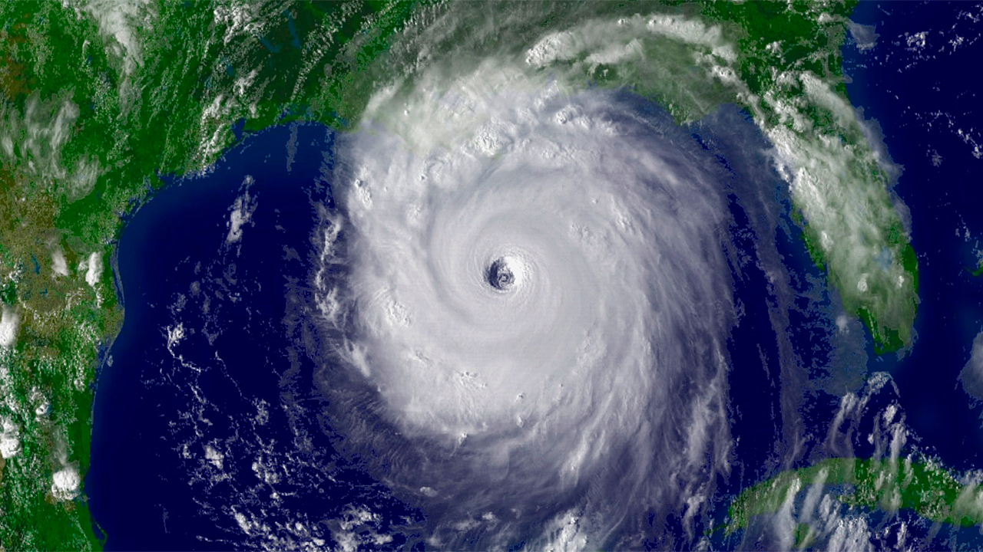
Hurricanes 101

Slide 4
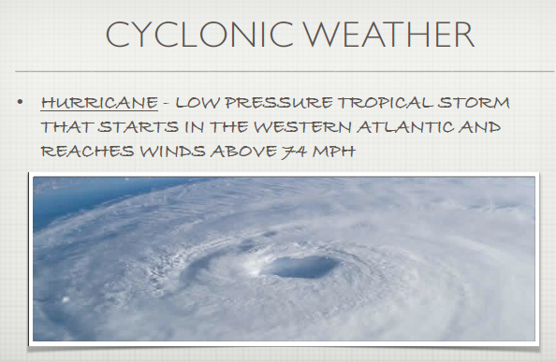

Slide 5
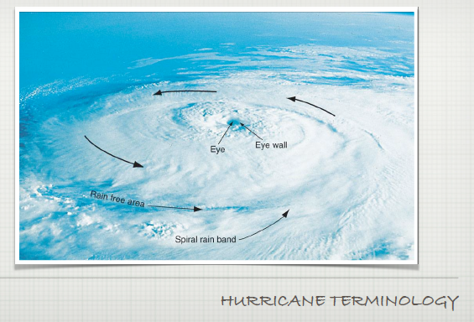

Slide 6
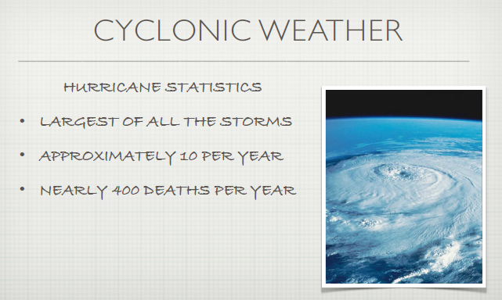

Slide 7
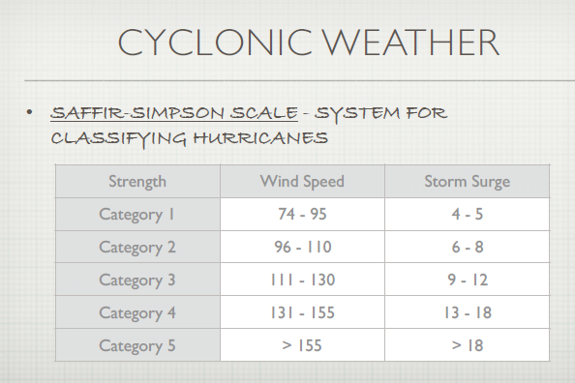

Slide 8
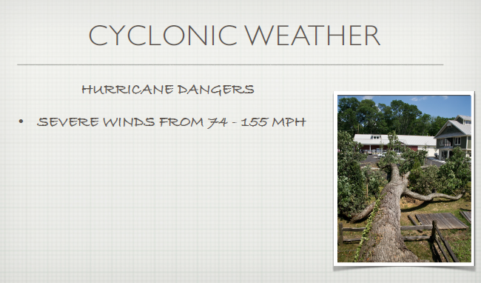
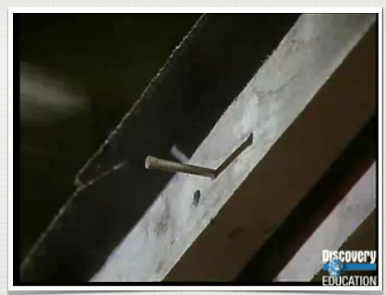

Slide 9
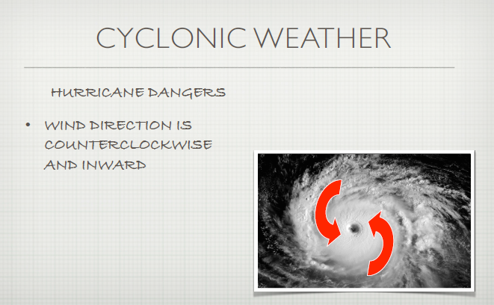
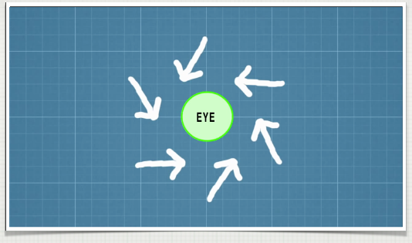
L

Slide 10
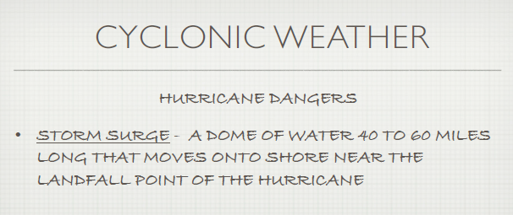
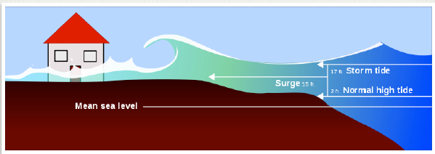

Slide 11
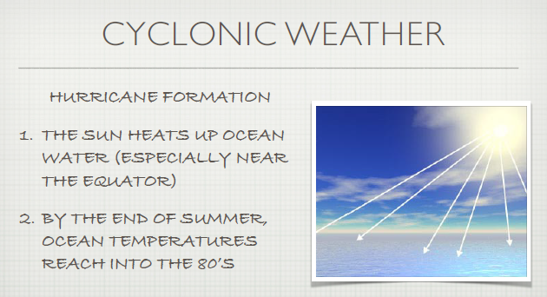

Slide 12
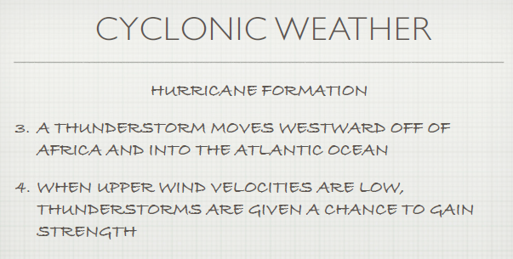

Slide 13
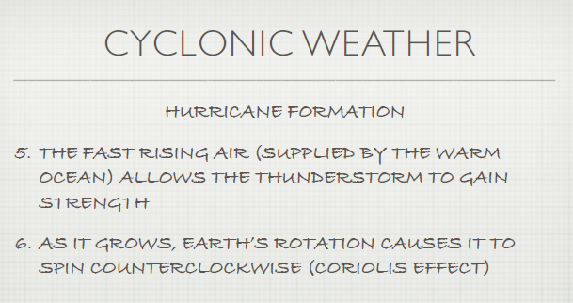

Slide 14
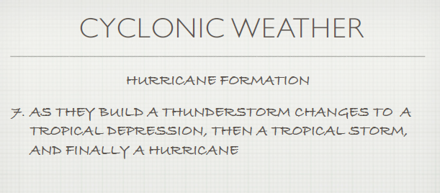

Slide 15
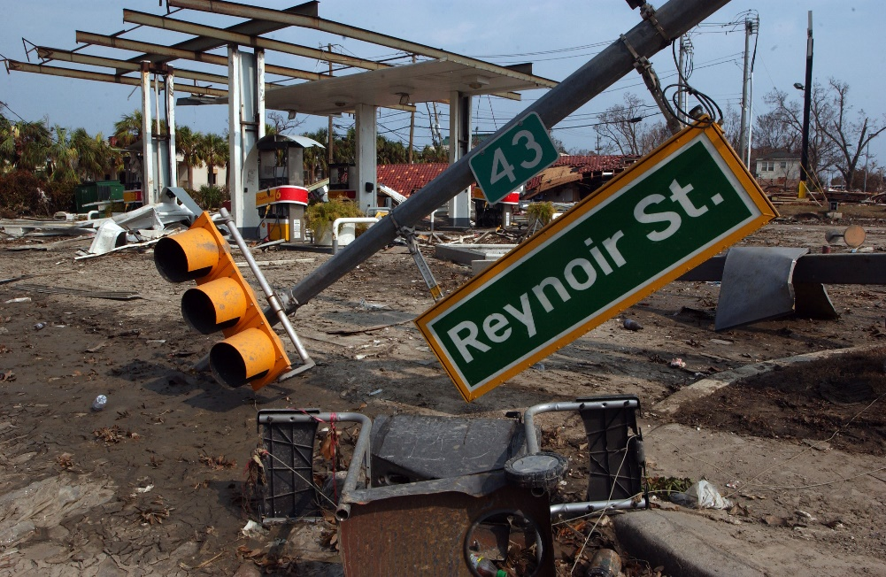
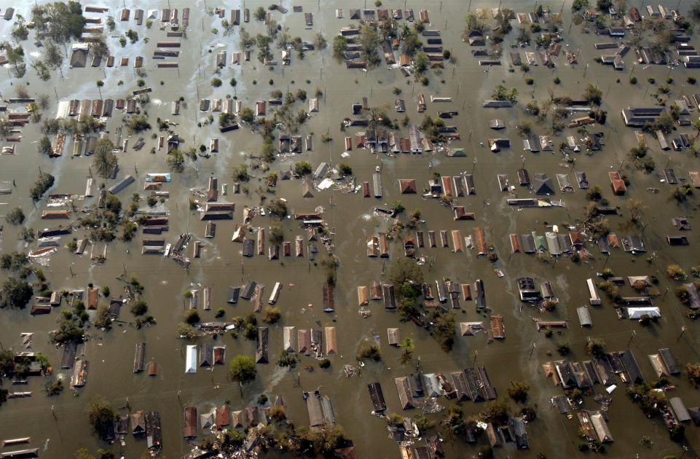
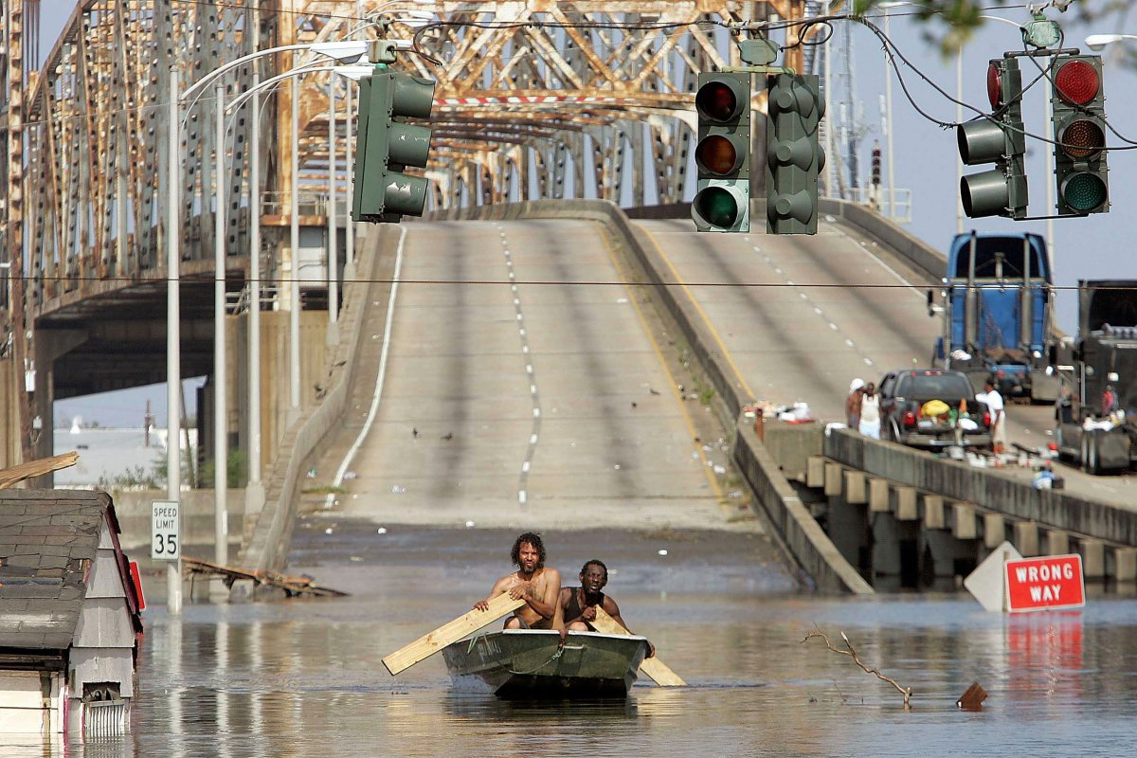
Hurricane Katrina Aftermath
Hurricane Katrina was the costliest natural disaster and one of the five deadliest hurricanes in the history of the United States.
Highest wind speed: 174 mph
Date: August 23, 2005 – August 31, 2005
Category: Category 5 Hurricane (SSHS)
Fatalities: 1,836
Affected areas: New Orleans, Cuba, Louisiana, Alabama, Georgia, & More
(Source: Wikipedia)

Slide 16
Questions?

Slide 17
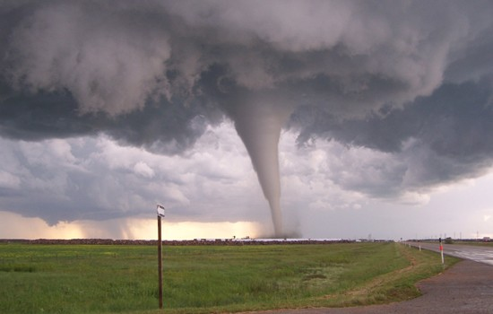
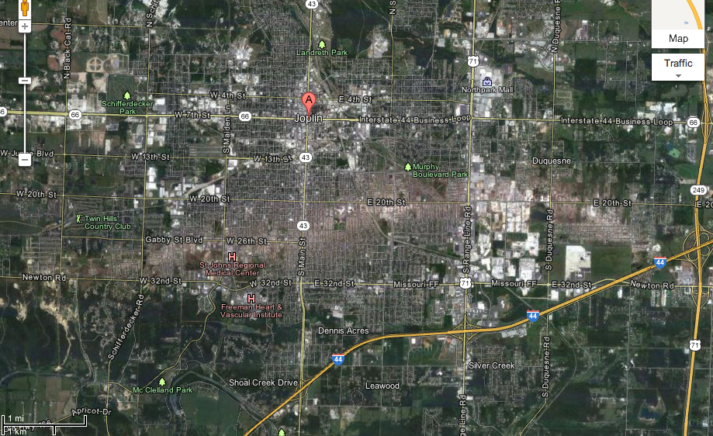
Joplin, Missouri Tornado: May 2011
The 2011 Joplin tornado was a catastrophic EF5-rated multiple-vortex tornado that struck Joplin, Missouri, late in the afternoon of Sunday, May 22, 2011. It was part of a larger late-May tornado outbreak and reached a maximum width of nearly 1 mile (1.6 km) during its path through the southern part of the city.
(Source: Wikipedia)

Slide 18
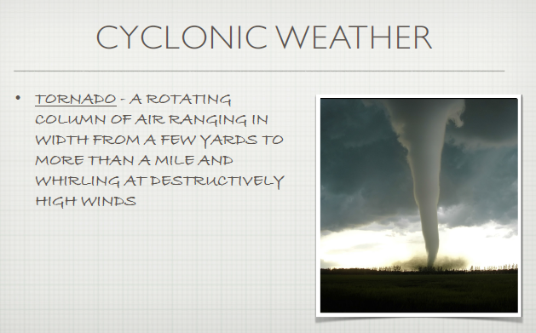

Slide 19
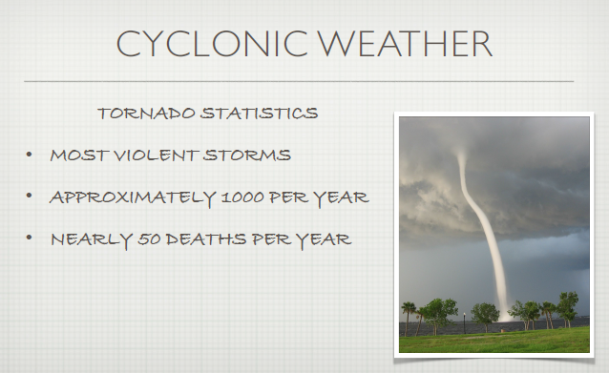

Slide 20
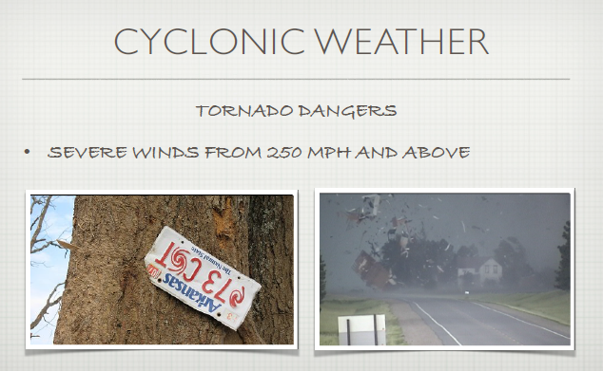

Slide 21
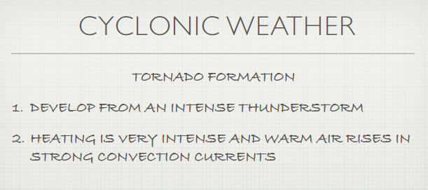

Slide 22
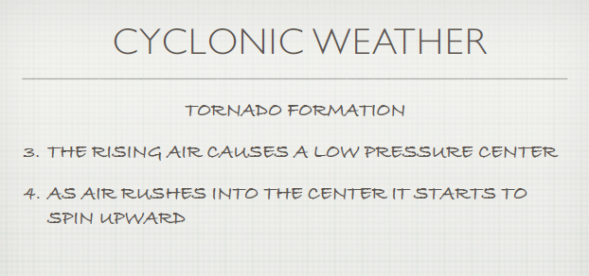

Slide 23
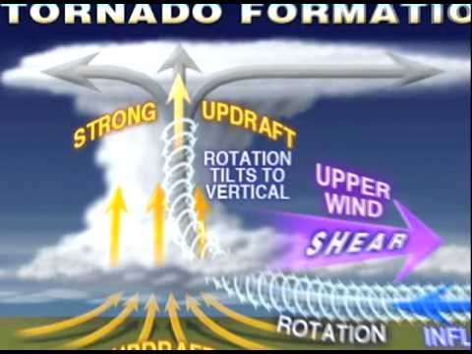
“How Tornadoes Form”

Slide 24
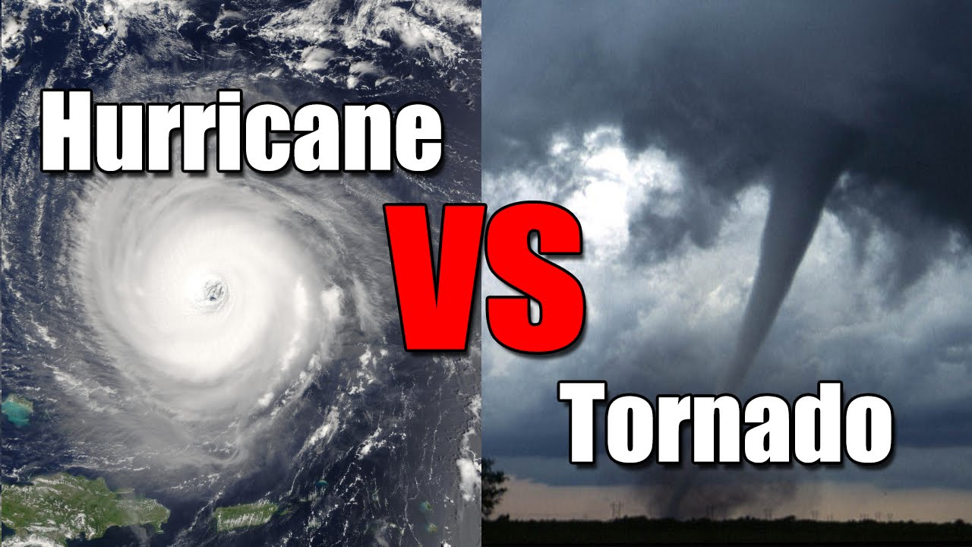
Hurricanes vs. Tornadoes:
How Are They Similar?
How Are They Different?

Slide 25
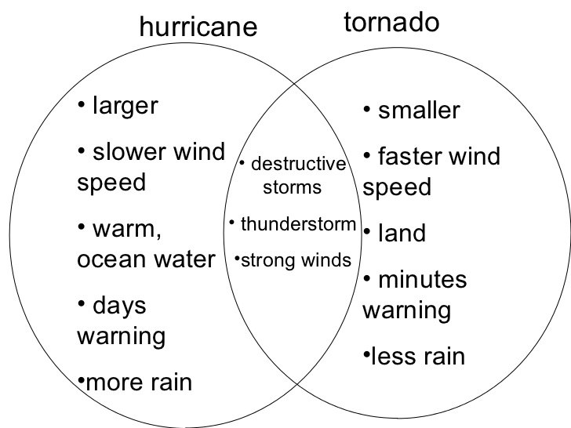
Hurricanes vs. Tornadoes:
How Are They Similar?
How Are They Different?

Slide 26
Questions?

Slide 27
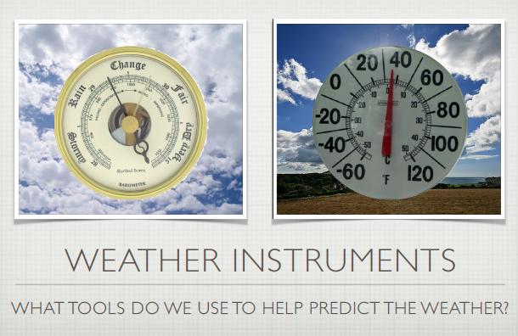

Slide 28
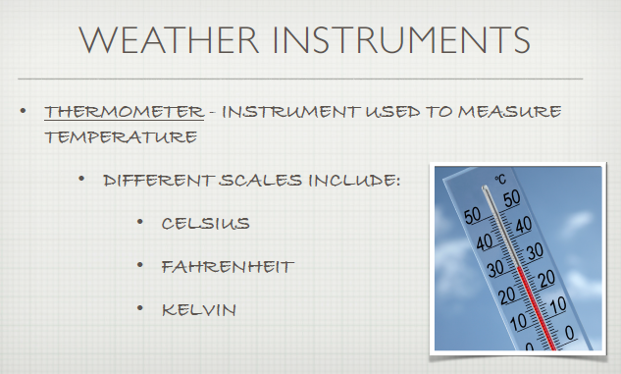

Slide 29
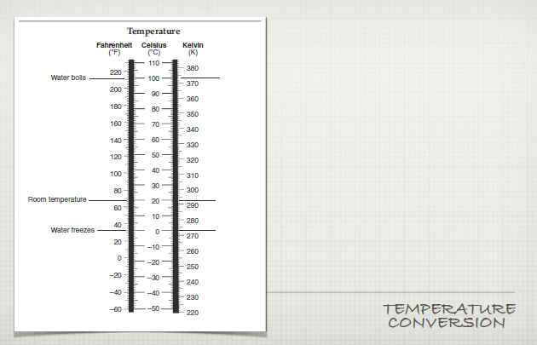
ESRT page 13

Slide 30
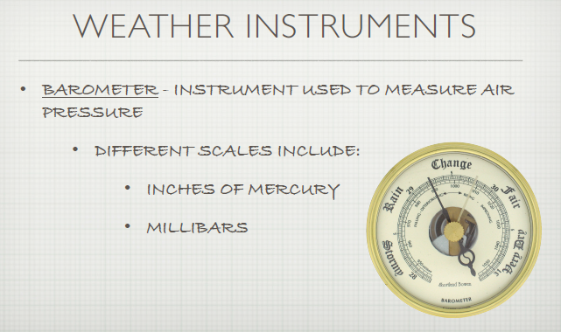

Slide 31
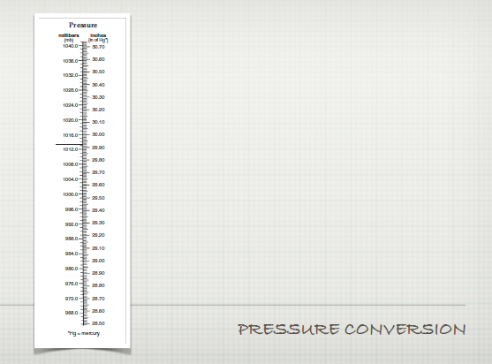
ESRT page 13

Slide 32
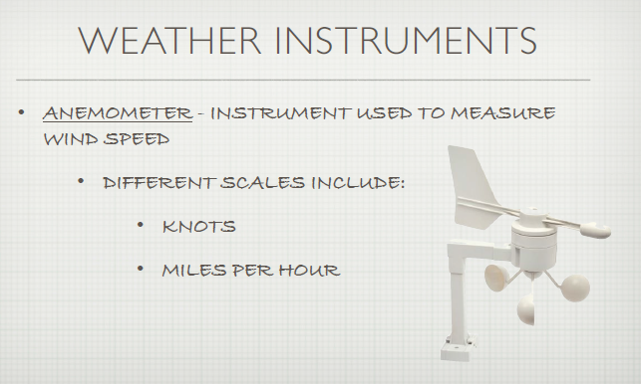

Slide 33
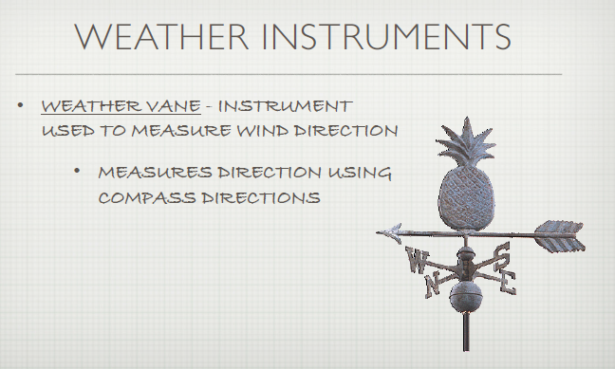

Slide 34
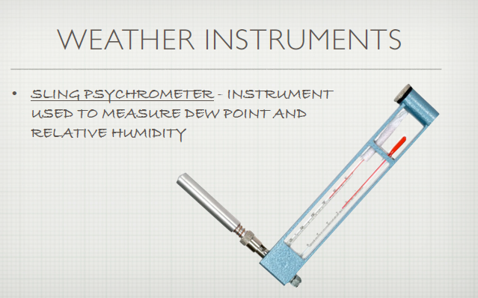

Slide 35
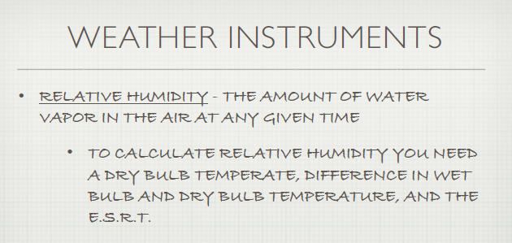
ESRT page 12

Slide 36
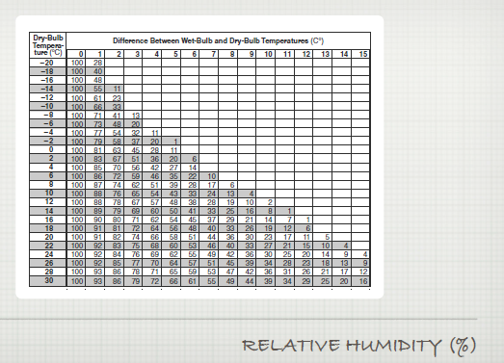
ESRT page 12

Slide 37
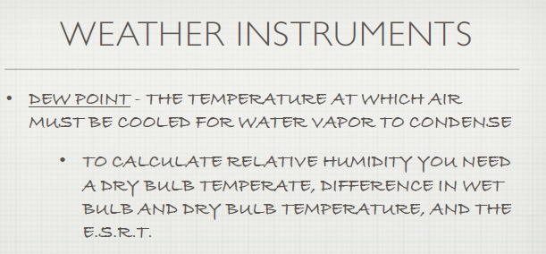
DEWPOINT
ESRT page 12

Slide 38
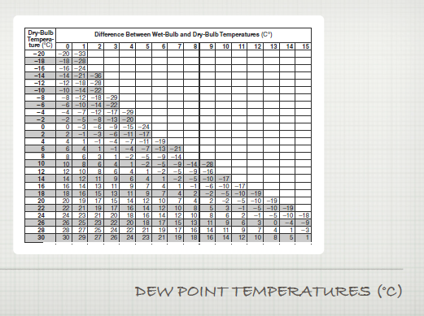
ESRT page 12

Slide 39
Questions?

Slide 40
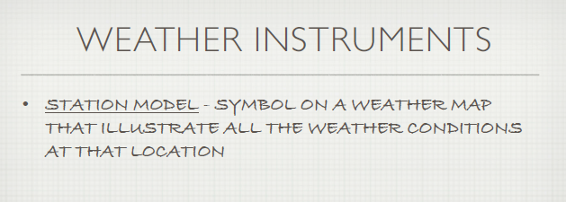
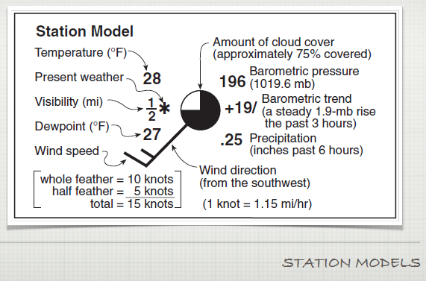
ESRT page 13

Slide 41
“Station Models”

Slide 42
Questions?

Slide 43
Lab 15: Weather Instruments
You are now ready to complete Lab 15: Weather Instruments
Worth: 90 Minutes
Use your notes and your understanding of station models to complete all activities in your lab

Slide 44
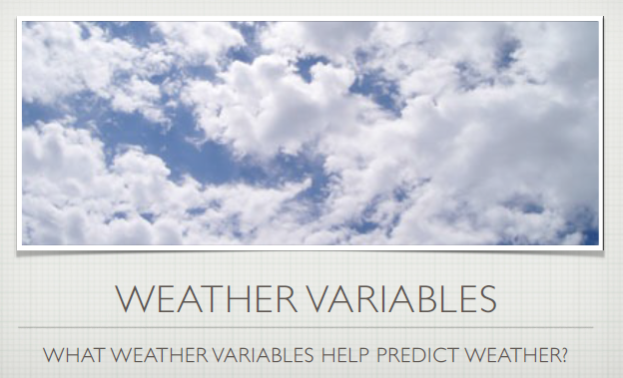

Slide 45
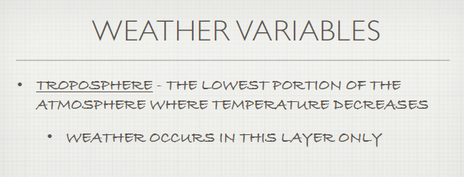
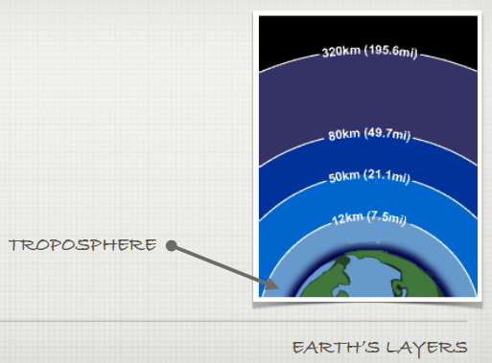
ESRT page 14

Slide 46
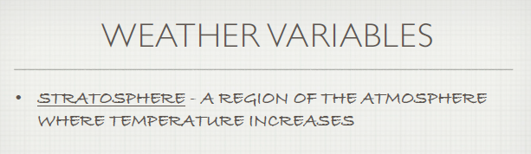
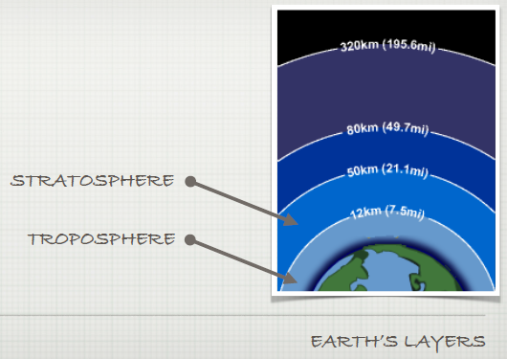
ESRT page 14

Slide 47


ESRT page 14

Slide 48
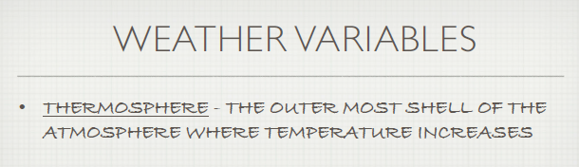
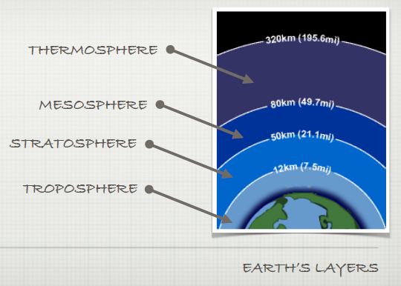
ESRT page 14

Slide 49

ESRT page 14

Slide 50


Slide 51


Slide 52


Slide 53


ESRT page 14

Slide 54


Slide 55


Slide 56


Slide 57


Slide 58


Slide 59


Slide 60


Slide 61
Questions?

Slide 62
Lab 16: Weather Variables
You are now ready to complete Lab 16: Weather Variables
Worth: 90 Minutes
Use your notes and your understanding of drawing isolines, calculating gradient, and creating line graphs to complete all activities in your lab

Slide 63


Slide 64


Slide 65

ESRT page 13

Slide 66


Slide 67


Slide 68


Slide 69

ESRT page 13

Slide 70


Slide 71


Slide 72



Slide 73


Slide 74



Slide 75



Slide 76



Slide 77


Slide 78
Questions?

Slide 79
Unit 8
Part II: Water & Climate
Topic 1: the water cycle
Topic 2: climate variables
Topic 3: rainfall patterns

Slide 80


Slide 81


Slide 82


Slide 83


Slide 84


Slide 85


Slide 86


Slide 87


Slide 88


Slide 89


Slide 90


Slide 91


Slide 92


Slide 93



Slide 94


Slide 95
“The Water Cycle”

Slide 96

Water Cycle Review: “Fill in the Blanks”

Slide 97
Water Cycle Review: “Fill in the Blanks”
Precipitation
Condensation
Transpiration
Runoff
Evaporation
Infiltration
Water Table

Slide 98
Questions?

Slide 99

Water Cycle Review: “Fill in the Blanks”

Slide 100
Before we look at “climate variables,” first we must ask…
WHAT IS CLIMATE??
CLIMATE IS…

Slide 101


Slide 102


Slide 103


Slide 104


Slide 105

ESRT pg. 14
In Your Notes…
Shade easterly winds GREEN
Shade westerly winds ORANGE
Color “wet” belts
BLUE
Color “dry” belts
RED

Slide 106


Slide 107


Slide 108

, Lake Ontario Shore

Slide 109


Slide 110

ESRT pg. 4
In Your Notes…
Trace cold current lines/arrows (thick) BLUE
Trace warm current lines/arrows (thin) RED

Slide 111


Slide 112

ESRT pg. 14
In Your Notes…
Shade the temperature line RED as it increases
Shade the temperature line BLUE as it decreases
Shade the layers of the atmosphere as follows:
  Troposphere = Green
  Stratosphere = Yellow
  Mesosphere = Purple
  Thermosphere = Orange

Slide 113


Slide 114


Windward Side
(moist)
Leeward
Side
(dry)
Windward Side
(moist)
Leeward
Side
(dry)

Slide 115


Slide 116


Slide 117


Slide 118


Slide 119
Questions?

Slide 120
Lab 17: Climate Variables
You are now ready to complete Lab 17: Climate Variables
Worth: 120 Minutes
Use your notes and your understanding of the factors that influence the climate to complete all activities in your lab

Slide 121


Slide 122




Slide 123

HAWAII

Slide 124



Slide 125


Slide 126



Slide 127

opposite

Slide 128


Slide 129


Slide 130
Questions?

